Slide 1
Two-Way Selection
The decision is described to the computer as a conditional statement that can be answered either true or false. If the answer is true, one or more action statements are executed. If the answer is false, then a different action or set of actions is executed.
Topics discussed in this section:
if…else and Null else Statement
Nested if Statements and Dangling else Problem
Simplifying if Statements
Conditional Expressions
Computer Science: A Structured Programming Approach Using C

Slide 2
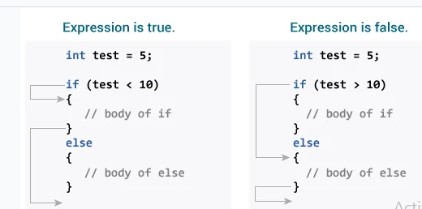
if...else Logic Flow
Computer Science: A Structured Programming Approach Using C

Slide 3
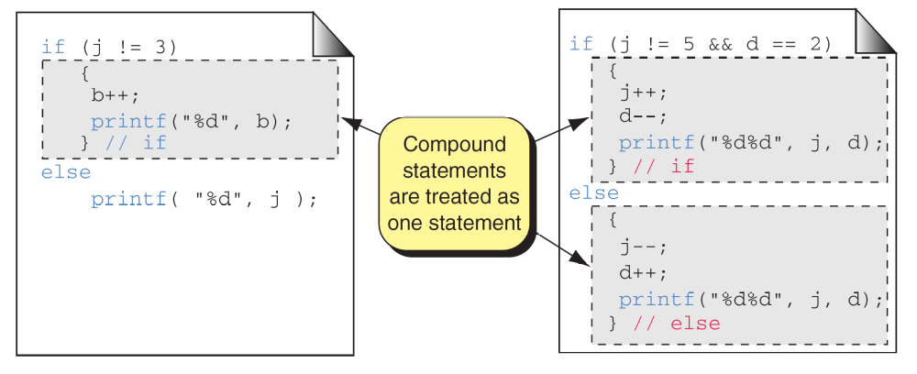
Compound Statements in an if...else
Computer Science: A Structured Programming Approach Using C

Slide 4
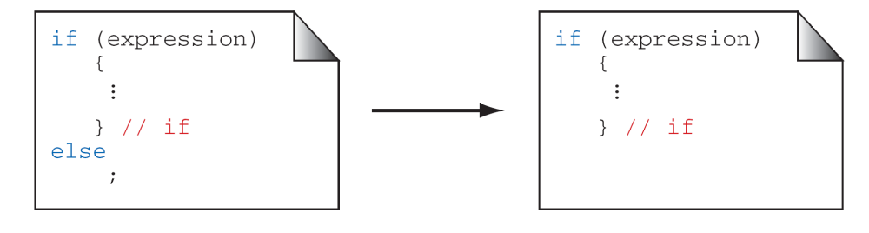
A Null else Statement
Computer Science: A Structured Programming Approach Using C

Slide 5
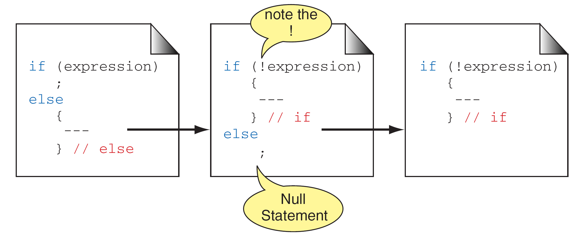
A Null if Statement
Computer Science: A Structured Programming Approach Using C

Slide 6
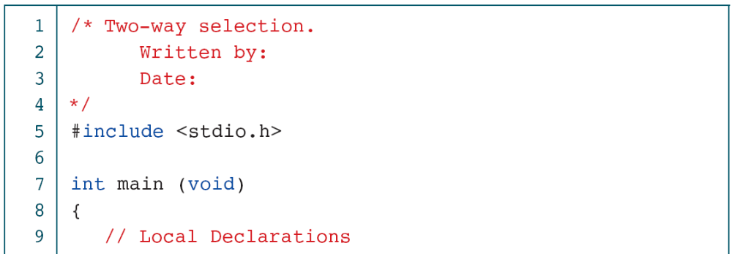
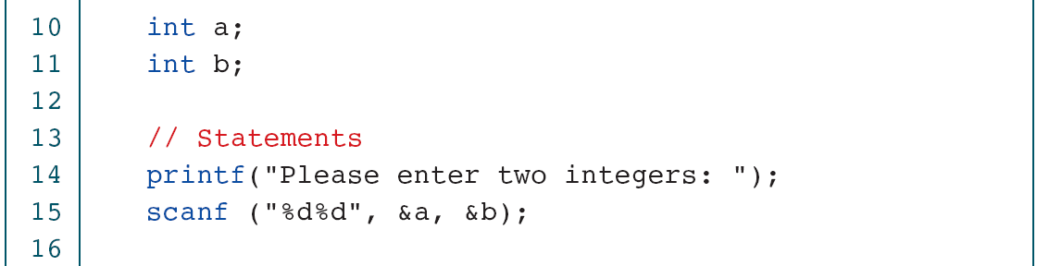
PROGRAM 5-3
Two-way Selection
Computer Science: A Structured Programming Approach Using C

Slide 7
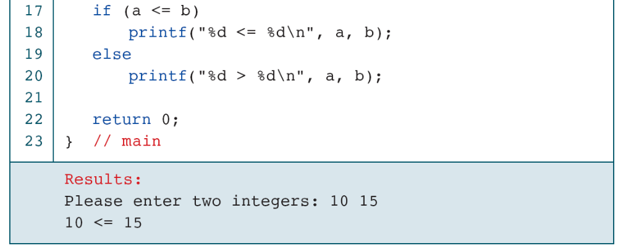
PROGRAM 5-3
Two-way Selection
Computer Science: A Structured Programming Approach Using C

Slide 8
Nested if Statements
Computer Science: A Structured Programming Approach Using C

Slide 9
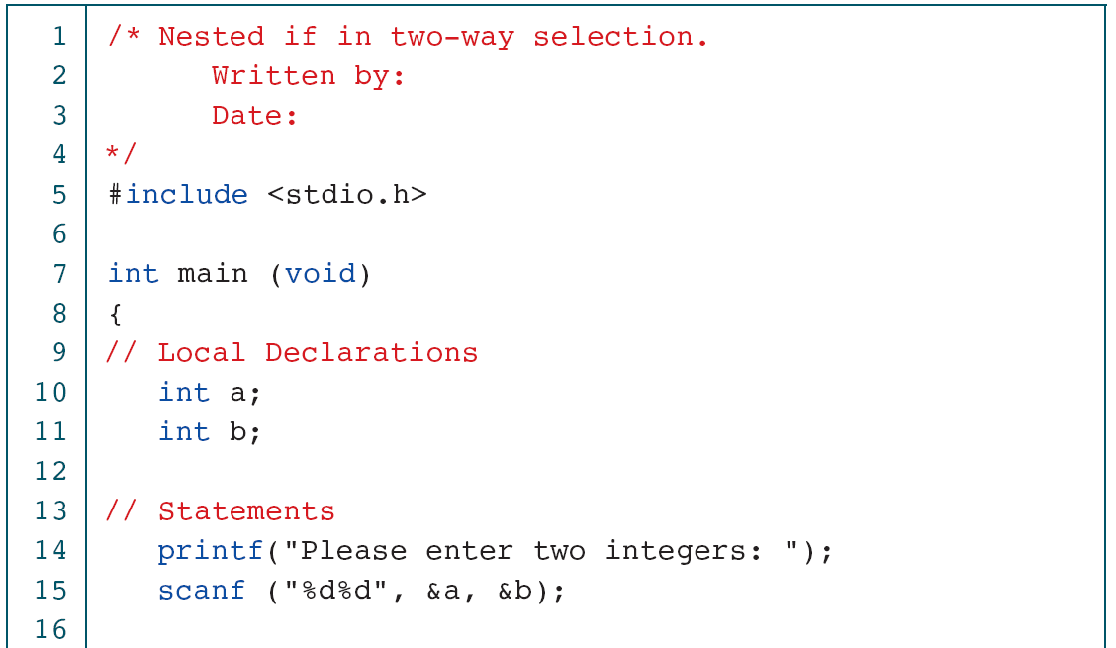
PROGRAM 5-4
Nested if Statements
Computer Science: A Structured Programming Approach Using C

Slide 10
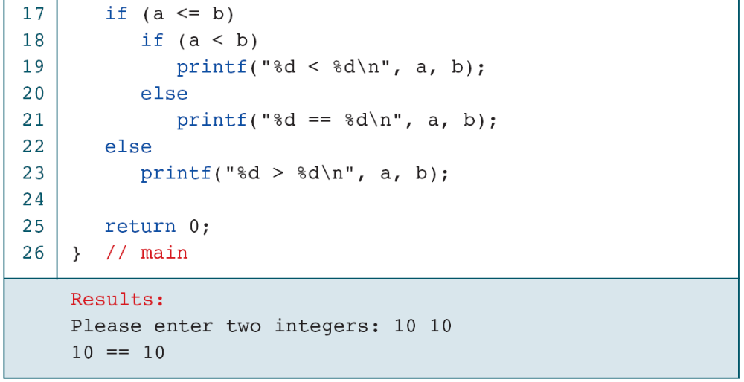
PROGRAM 5-4
Nested if Statements
Computer Science: A Structured Programming Approach Using C

Slide 11
Note
else is always paired with the most recent unpaired if.
Computer Science: A Structured Programming Approach Using C

Slide 12
FIGURE 5-14 Dangling else
Computer Science: A Structured Programming Approach Using C

Slide 13
FIGURE 5-15 Dangling else Solution
Computer Science: A Structured Programming Approach Using C

Slide 14
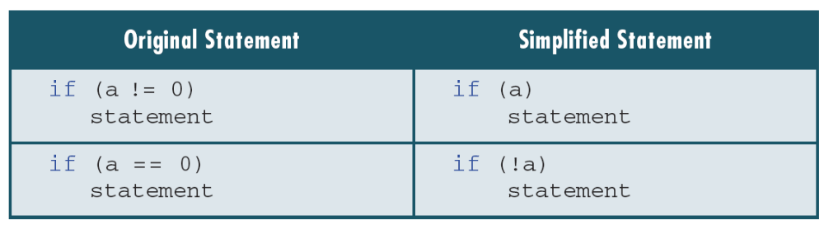
Table 5-3
Simplifying the Condition
Computer Science: A Structured Programming Approach Using C

Slide 15
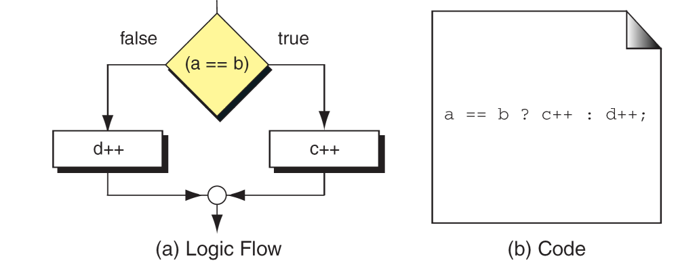
FIGURE 5-16 Conditional Expression
Computer Science: A Structured Programming Approach Using C

Slide 16
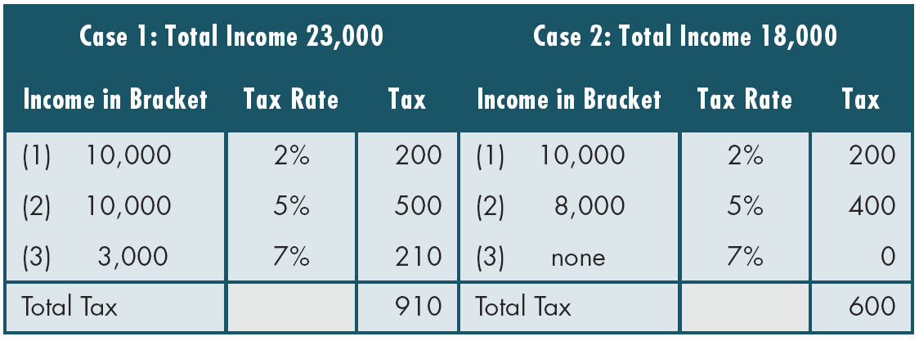
Table 5-4
Examples of Marginal Tax Rates
Computer Science: A Structured Programming Approach Using C

Slide 17
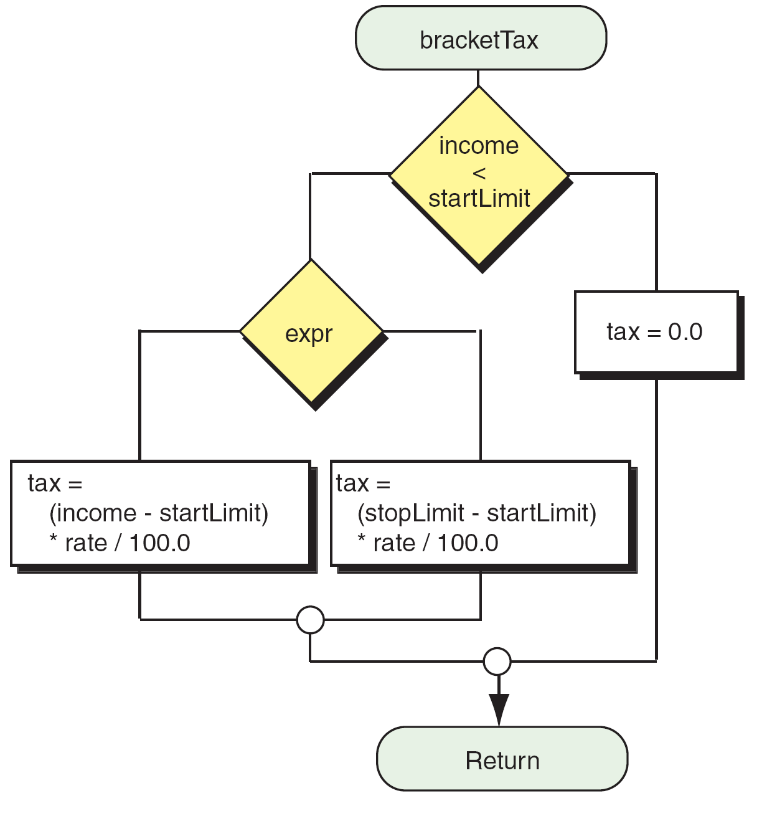
FIGURE 5-18 Design for Program 5-5 (Part III)
Computer Science: A Structured Programming Approach Using C

Slide 18
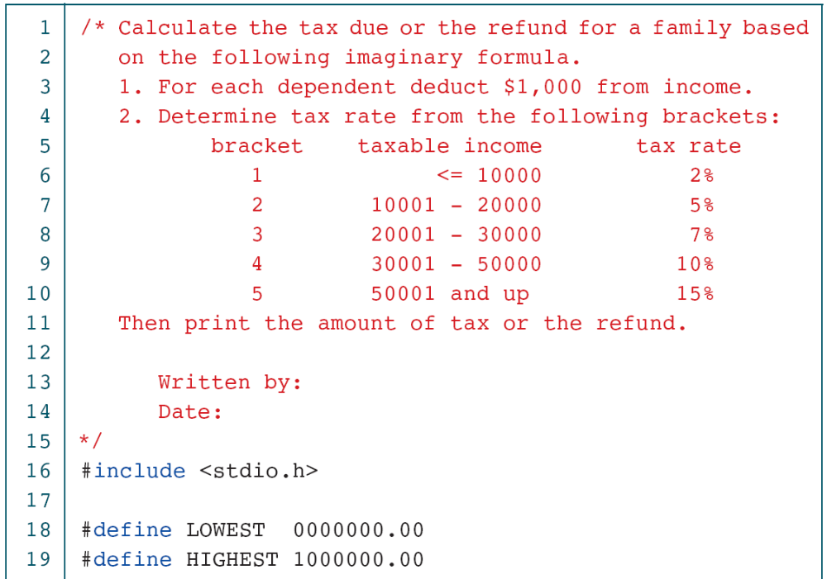
PROGRAM 5-5
Calculate Taxes
Computer Science: A Structured Programming Approach Using C

Slide 19
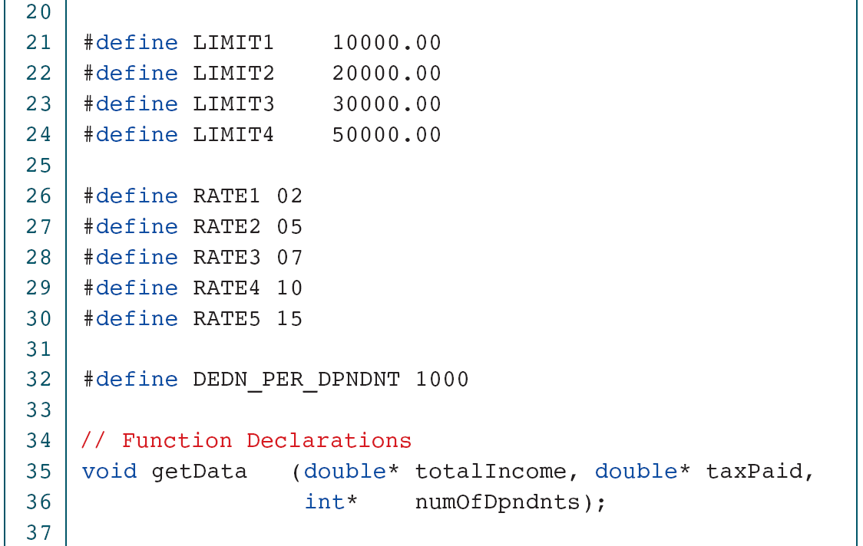
PROGRAM 5-5
Calculate Taxes
Computer Science: A Structured Programming Approach Using C

Slide 20
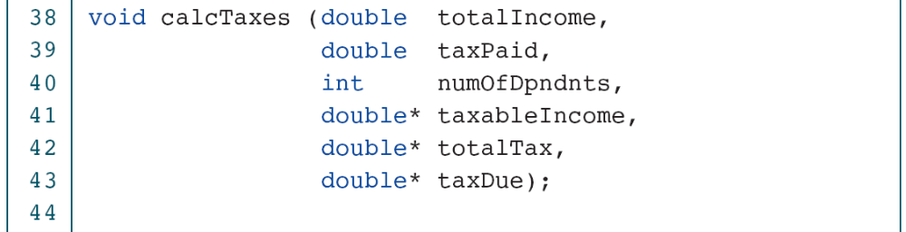
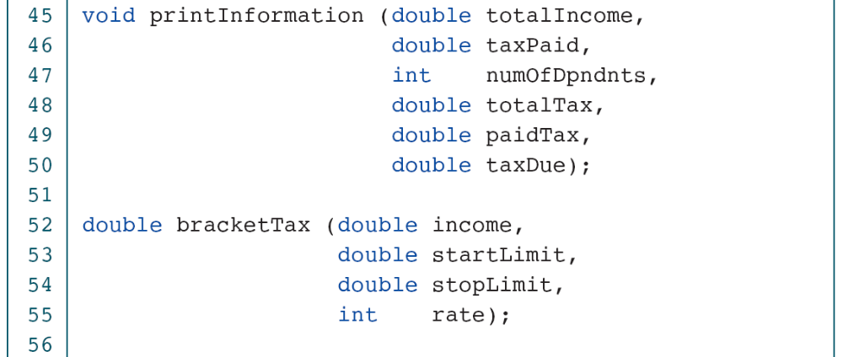
PROGRAM 5-5
Calculate Taxes
Computer Science: A Structured Programming Approach Using C

Slide 21
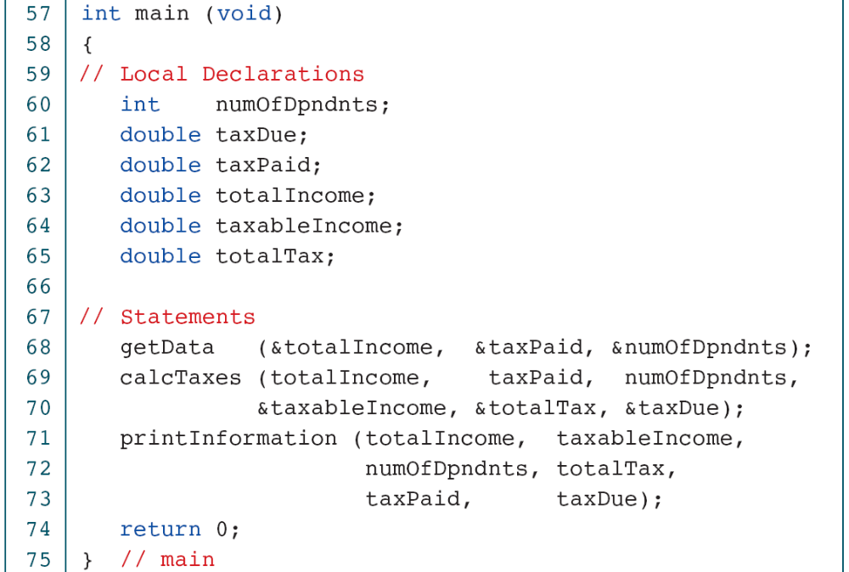
PROGRAM 5-5
Calculate Taxes
Computer Science: A Structured Programming Approach Using C

Slide 22
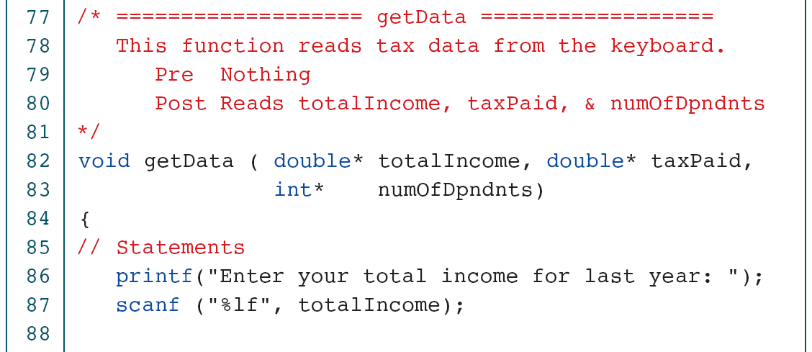
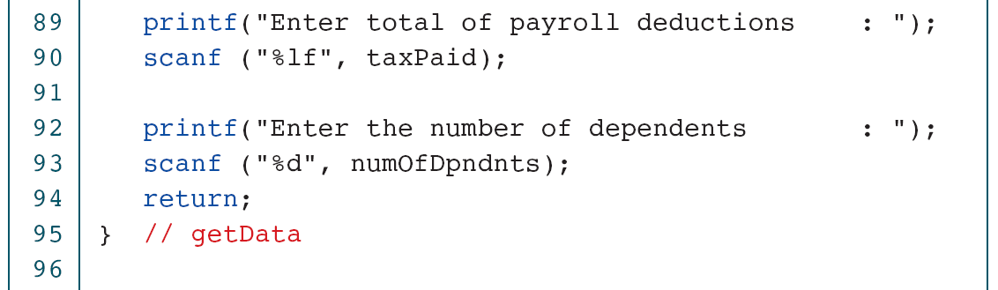
PROGRAM 5-5
Calculate Taxes
Computer Science: A Structured Programming Approach Using C

Slide 23
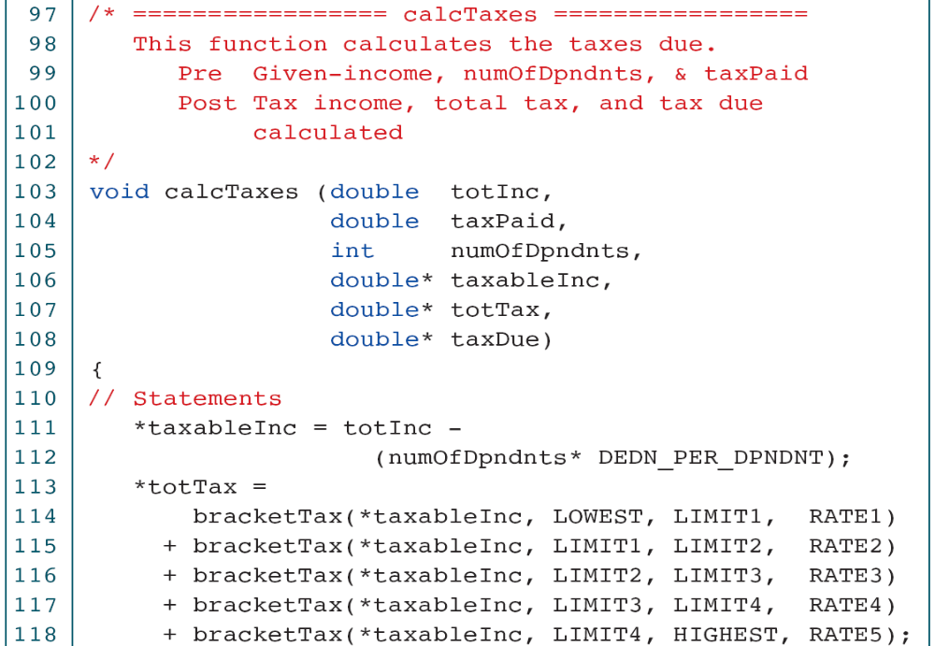
PROGRAM 5-5
Calculate Taxes
Computer Science: A Structured Programming Approach Using C

Slide 24
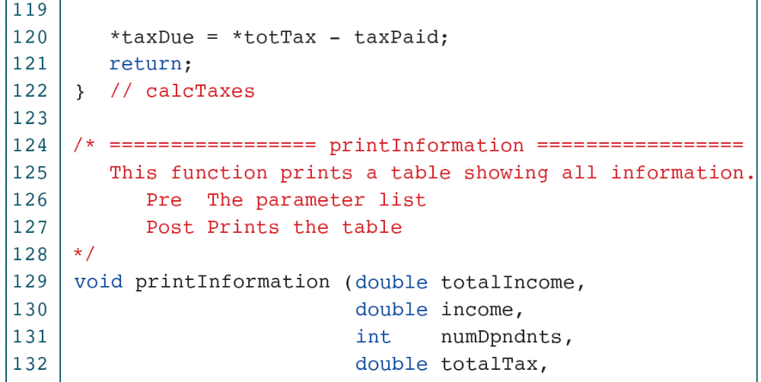
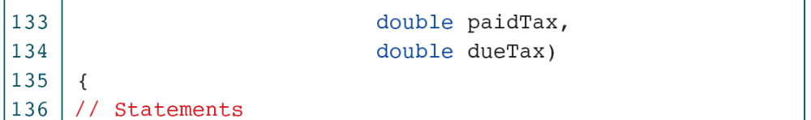
PROGRAM 5-5
Calculate Taxes
Computer Science: A Structured Programming Approach Using C

Slide 25
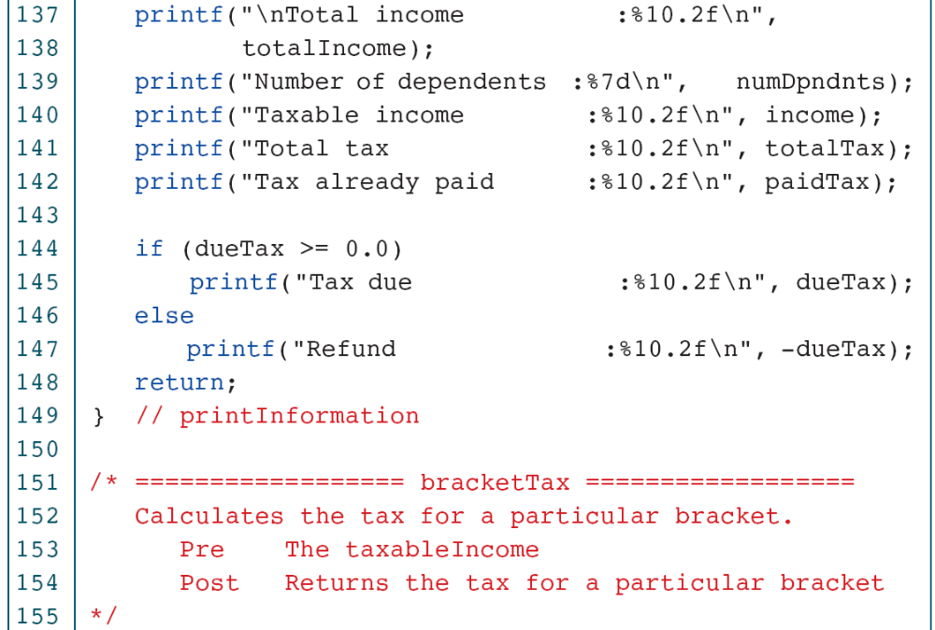
PROGRAM 5-5
Calculate Taxes
Computer Science: A Structured Programming Approach Using C

Slide 26
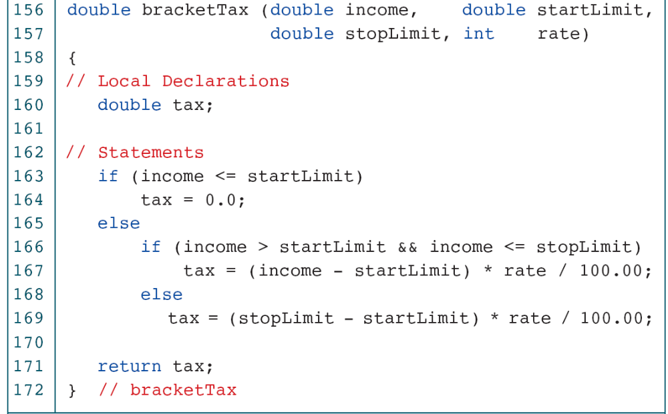
PROGRAM 5-5
Calculate Taxes
Computer Science: A Structured Programming Approach Using C

Slide 27
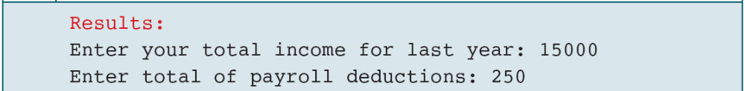
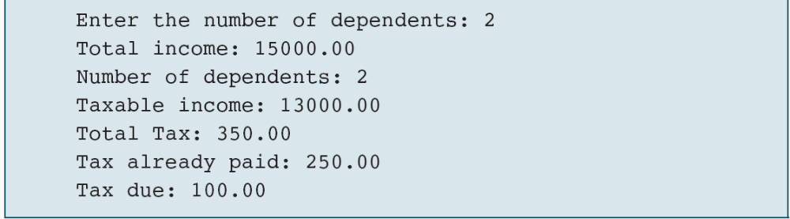
PROGRAM 5-5
Calculate Taxes
Computer Science: A Structured Programming Approach Using C

